Slide 1
Chapter 5
Variability: Dealing with Diversity
Elsevier/Academic Press
© Andrew F. Siegel, 2016

Slide 2
Variability: Introduction
Also known as dispersion, spread, uncertainty, diversity, risk
Example data: 2, 2, 2, 2, 2, 2, 2
  Variability = 0
Example data: 1, 3, 2, 2, 1, 2, 3
  How much variability?
  Look at how far each data value is from average X = 2:
  Deviations from average are -1, 1, 0, 0, -1, 0, 1
  Variability should be between 0 and 1
Elsevier/Academic Press
© Andrew F. Siegel, 2016

Slide 3
Examples
Stock market, daily change, is uncertain
  Not the same, day after day!
Risk of a business venture
  There are potential rewards, but possible losses
Uncertain payoffs and risk aversion
  Which would you rather have
    $1,000,000 for sure
    $0 or $2,000,000, each outcome equally likely
  Both have same average! ($1,000,000)
  Most would prefer the choice with less uncertainty
Elsevier/Academic Press
© Andrew F. Siegel, 2016

Slide 4
Standard Deviation S
Measures variability by answering:
  “Approximately how far from average are the data values?” (same measurement units as the data)
  The square root of the average squared deviation
    (dividing by n-1 instead of n for a sample)
For a sample
For a population
(
X
−
X
)
2
+
(
X
−
X
)
2
+
...
+
(
X
−
X
)
2
S
=
1
2
n
n
−
1
(
X
−
μ
)
2
+
(
X
−
μ
)
2
+
...
+
(
X
−
μ
)
2
σ
=
1
2
N
“sigma”
N
Elsevier/Academic Press
© Andrew F. Siegel, 2016

Slide 5
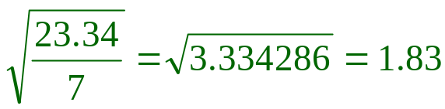
Example: Spending
Customers plan to spend ($thousands)
  3.8, 1.4, 0.3, 0.6, 2.8, 5.5, 0.9, 1.1
Average is 2.05. Sum of squared deviations is
  (3.8–2.05)²+(1.4–2.05)²+…+(1.1–2.05)² = 23.34
Divide by 8–1=7 and take square root:
Customers plan to spend about 1.83 (thousand, i.e., $1,830) more or less than the average, 2.05.
  Some plan to spend more, others less than average
= Standard deviation
Elsevier/Academic Press
© Andrew F. Siegel, 2016

Slide 6
Example: Spending (continued)
On the histogram
  Average is located near the center of the distribution
  Standard deviation is a distance away from the average
  Standard deviation is the typical distance from average
3
2
Frequency
1
0
0
1
2
3
4
5
6
7
spending
S = 1.83
X = 2.05
S = 1.83
Elsevier/Academic Press
© Andrew F. Siegel, 2016

Slide 7
Normal Distribution and Std. Dev.
Fig 5.1.3
For a normal distribution only
  2/3 of data within one standard deviation of the average (either above or below)
  95% for 2 std. devs.
  99.7% for 3
one
standard
deviation
one
standard
deviation
2/3 of data
95% of the data
99.7% of the data
Elsevier/Academic Press
© Andrew F. Siegel, 2016

Slide 8
Skewed Distribution and Std. Dev.
No simple rule for percentages within one, two, three standard deviations of the average
Standard deviation retains its interpretation as the standard measure of
  Typically how far the observations are from average
Elsevier/Academic Press
© Andrew F. Siegel, 2016

Slide 9
Example: Quality Control Charts
Control limits are often set at
  3 standard deviations from the average
If the process is normally distributed, then
  Over the long run, observations will stay within the control limits 99.7% of the time
If the process goes out of control, you will know
100
Out of control
50
Quality
0
Elsevier/Academic Press
© Andrew F. Siegel, 2016

Slide 10
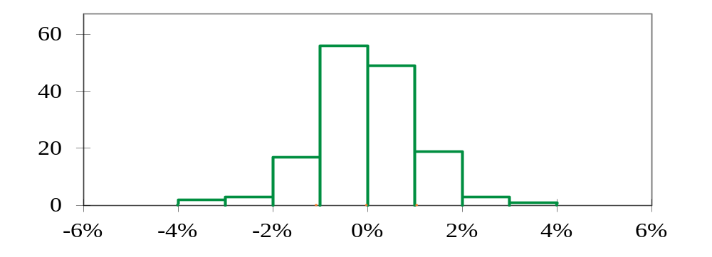
Example: The Stock Market
Daily stock market returns, Dow Jones Index, second half of 2015. Standard deviation is 1.06%
  Average daily percent change: -0.0164%, close to 0
  Typical day: about 1 percentage point up or down
Frequency (days)
Stock market return
One
standard
deviation
One
standard
deviation
Average
Elsevier/Academic Press
© Andrew F. Siegel, 2016

Slide 11
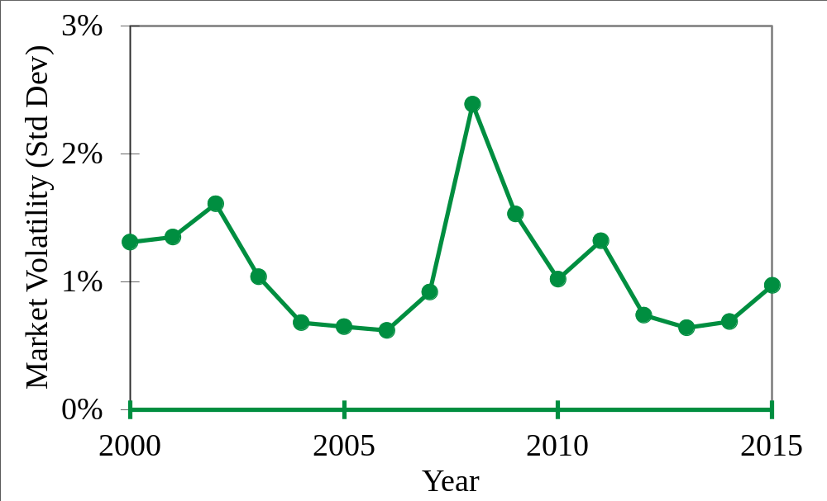
History of Stock Market Volatility
Standard deviation of daily stock market returns, Dow Jones Index, each year from 2000 to 2015
Financial Crisis
Dot-Com
Bust
Elsevier/Academic Press
© Andrew F. Siegel, 2016

Slide 12
Diversification in the Stock Market
Diversification is holding more than one security
Diversification typically reduces risk
  Limits exposure to extreme movements of each security
  Note reduced standard deviation when holding two stocks, with risk measured by standard deviation of daily rate of return for first half of 2010:
  Risk
  Corning Only 2.12%
  JPMorgan Chase Only 2.07%
  Both together 1.87%
Elsevier/Academic Press
© Andrew F. Siegel, 2016

Slide 13
Mining the Donations Database
Fig 5.1.11
989 people made donations
  Average donation $15.77, standard deviation $11.68
  Skewed distribution for donation amounts
300
250
200
Number of people
150
100
50
0
$0
$20
$40
$60
$80
$100
$120
One standard
deviation
One standard
deviation
Donation amount
Average donation
Elsevier/Academic Press
© Andrew F. Siegel, 2016

Slide 14
The Range
The difference: Largest – Smallest
Good features
  Easy and fast to compute
  Describe the data
  Check the data: Is the range too big to be reasonable?
Problem
  Very sensitive to just two data values
    Compare to standard deviation, which combines all data values
Elsevier/Academic Press
© Andrew F. Siegel, 2016

Slide 15
Example: Spending
$Thousands: 3.8, 1.4, 0.3, 0.6, 2.8, 5.5, 0.9, 1.1
The range is 5.2
  larger than the standard deviation, 1.83
The range
5.5–0.3 = 5.2
3
2
Frequency
1
0
0
1
2
3
4
5
6
7
spending
Average
One standard deviation
Elsevier/Academic Press
© Andrew F. Siegel, 2016

Slide 16
Coefficient of Variation
A relative measure of variability
The ratio: Standard deviation divided by average
  For a sample: S/X
  For a population: σ/μ
No measurement units. A pure number. Answers:
  “Typically, in percentage terms, how far are data values from average?”
Useful for comparing situations of different sizes
  To see how variability compares after adjusting for size
Elsevier/Academic Press
© Andrew F. Siegel, 2016

Slide 17
Example: Portfolio Performance
You have invested $100 in each of 5 stocks
  Results: $116, 83, 105, 113, 98
  Average is $103, std. dev. is $13.21
Your friend has invested $1,000 in each stock
  Results: $1,160, 830, 1,050, 1,130, 980
  Average is $1,030, std. dev. is $132.10
Coefficients of variation are identical
  13.21/103 = 132.10/1,030 = 0.128 = 12.8%
Typically, results for these 5 stocks were approximately 12.8% from their average value
Elsevier/Academic Press
© Andrew F. Siegel, 2016

Slide 18
Adding a Constant to the Data
If the same number is added to each data value:
  The average changes by this same number
    The center of the distribution shifts by the same amount
  The standard deviation is unchanged
    Each data value stays the same distance from average
Example: Order amounts: $3, 6, 9, 5, 8
  Average is $6.20, std. dev. is $2.39
  Now add shipping and handling, $1 per order:
  $4, 7, 10, 6, 9
  Average rises by $1 to $7.20, but std. dev. is still $2.39
Elsevier/Academic Press
© Andrew F. Siegel, 2016

Slide 19
Multiplying the Data by a Constant
If each data value is multiplied by some number:
  The average is multiplied by this same number
    The center of the distribution shifts by the same multiple
  The standard deviation is also multiplied by this same number (after ignoring any minus sign)
    The distribution is widened (or narrowed) by this factor
Example: Order amounts: $3, 6, 9, 5, 8
  Average is $6.20, std. dev. is $2.39
  Add 10% sales tax: $3.30, $6.60, $9.90, $5.50, $8.80
  Average rises by 10% to $6.82
  Std. dev. also rises by 10%, to $2.63
Elsevier/Academic Press
© Andrew F. Siegel, 2016

Slide 20
Example: International Exchange Rates
Suppose 1 euro is worth $1.09
  Assume for now that this rate is constant
Your firm is anticipating
  Average profits worth 850,000 euros
  Standard deviation (uncertainty) of 100,000 euros
In dollars, after conversion, your firm anticipates
  Average profits worth 850,000*1.09 = $926,500
  Standard deviation of 100,000*1.09 = $109,000
Relative risk is the same in $ and in euros
  Coefficient of variation is 11.8%
Elsevier/Academic Press
© Andrew F. Siegel, 2016

